Slide 1
CONCURRENCY
CONTROL

Slide 2
Definition
Concurrency Control is the management procedure that is required for controlling concurrent execution of the operations that take place on a database.
But before knowing about concurrency control, we should know about concurrent execution.

Slide 3
Concurrent Execution
In a multi-user system, multiple users can access and use the same database at one time, which is known as the concurrent execution of the database.
It means that the same database is accessed simultaneously on a multi-user system by different users.
While working on the database transactions, there occurs the requirement of using the database by multiple users for performing different operations, and in that case, concurrent execution of the database is performed.

Slide 4
Concurrent Execution
The thing is that the simultaneous execution that is performed should be done in an interleaved manner, and no operation should affect the other executing operations, thus maintaining the consistency of the database.
Thus, on making the concurrent execution of the transaction operations, there occur several challenging problems that need to be solved.

Slide 5
Problems with concurrent execution
Some problems may occur during concurrent execution. Such as:
Lost Update Problem(W-W Conflict)
Dirty Read Problem(W-R Conflict)
Unrepeatable Read Problem(R-W Conflict)

Slide 6
Lost Update Problem
The problem occurs when two different database transactions perform the read/write operations on the same database items in an interleaved manner (i.e., concurrent execution) that makes the values of the items incorrect hence making the database inconsistent.

Slide 7
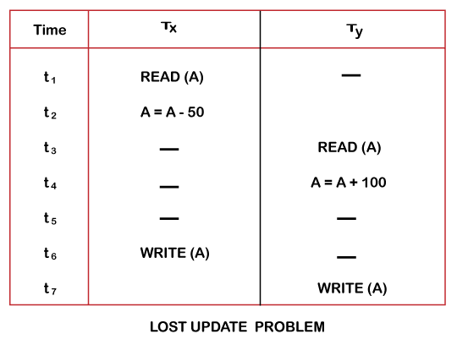
Lost Update Problem

Slide 8
Dirty Read Problem
The dirty read problem occurs when one transaction updates an item of the database, and somehow the transaction fails, and before the data gets rollback, the updated database item is accessed by another transaction. There comes the Read-Write Conflict between both transactions.

Slide 9
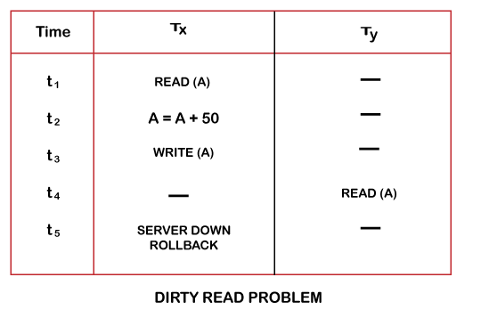
Dirty Read Problem

Slide 10
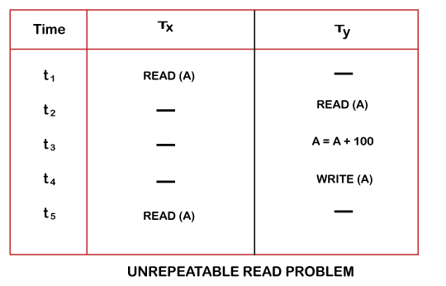
Unrepeatable Read Problem
Also known as Inconsistent Retrievals Problem that occurs when in a transaction, two different values are read for the same database item.

Slide 11
Concurrency Control
Concurrency Control is the working concept that is required for controlling and managing the concurrent execution of database operations and thus avoiding the inconsistencies in the database.
Thus, for maintaining the concurrency of the database, we have the concurrency control protocols.

Slide 12
Concurrency Control Protocols
The concurrency control protocols ensure the atomicity, consistency, isolation, durability and serializability of the concurrent execution of the database transactions. The protocols are categorized as:
Lock Based Concurrency Control Protocol
Time Stamp Concurrency Control Protocol
Validation Based Concurrency Control Protocol

Slide 13
Lock Based Protocols
In this type of protocol, any transaction cannot read or write data until it acquires an appropriate lock on it. There are two types of lock:
Shared Lock
Exclusive Lock

Slide 14
Shared Locks
It is also known as a Read-only lock.
In a shared lock, the data item can only read by the transaction.
It can be shared between the transactions because when the transaction holds a lock, then it can't update the data on the data item.

Slide 15
Exclusive Lock
In the exclusive lock, the data item can be both reads as well as written by the transaction.
This lock is exclusive, and in this lock, multiple transactions do not modify the same data simultaneously.

Slide 16
Types of Locking Protocols
There are four types of locking protocols available. Such as:
Simplistic Lock Protocol
Two-Phase Locking Protocol
Strict Two-Phase Locking Protocol
Rigorous Locking

Slide 17
Simplistic Lock Protocol
It is the simplest way of locking the data while transaction.
Simplistic lock-based protocols allow all the transactions to get the lock on the data before insert or delete or update on it.
It will unlock the data item after completing the transaction.

Slide 18
Two Phase Locking Protocol
The two-phase locking protocol divides the execution phase of the transaction into three parts.
In the first part, when the execution of the transaction starts, it seeks permission for the lock it requires.
In the second part, the transaction acquires all the locks. The third phase is started as soon as the transaction releases its first lock.
In the third phase, the transaction cannot demand any new locks. It only releases the acquired locks.

Slide 19
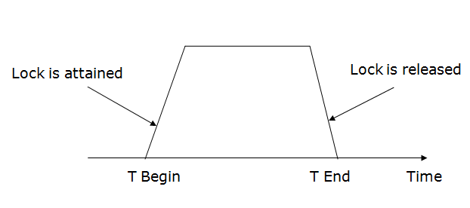
Two Phase Locking Protocol

Slide 20
Two Phase Locking Protocol
There are two phases of 2PL:
a) Growing phase: In the growing phase, a new lock on the data item may be acquired by the transaction, but none can be released.
b) Shrinking phase: In the shrinking phase, existing lock held by the transaction may be released, but no new locks can be acquired.

Slide 21
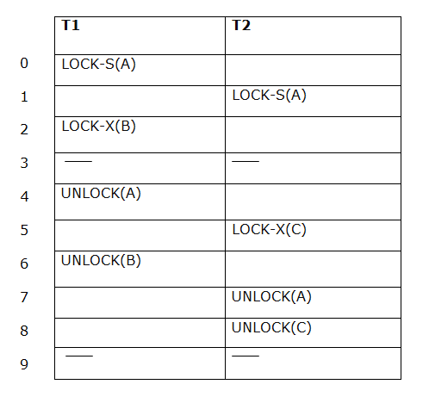
Growing and Shrinking Phase

Slide 22
Strict Two-Phase Locking
The first phase of Strict-2PL is similar to 2PL. In the first phase, after acquiring all the locks, the transaction continues to execute normally.
The only difference between 2PL and strict 2PL is that Strict-2PL does not release a lock after using it.
Strict-2PL waits until the whole transaction to commit, and then it releases all the locks at a time.
Strict-2PL protocol does not have shrinking phase of lock release.

Slide 23
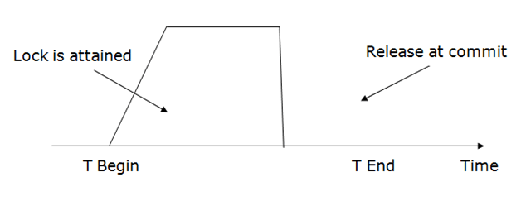
Strict Two-Phase Locking

Slide 24
Timestamp Concurrency Control
Timestamp is a unique identifier created by DBMS to identify a transaction.
Timestamp values are assigned in the order of creation of transaction.
Timestamp of a transaction T is denoted as TS(T).
This method of concurrency control never uses locks.

Slide 25
Timestamp Concurrency Control
The priority of the older transaction is higher that's why it executes first. To determine the timestamp of the transaction, this protocol uses system time or logical counter.
The lock-based protocol is used to manage the order between conflicting pairs among transactions at the execution time. But Timestamp based protocols start working as soon as a transaction is created.

Slide 26
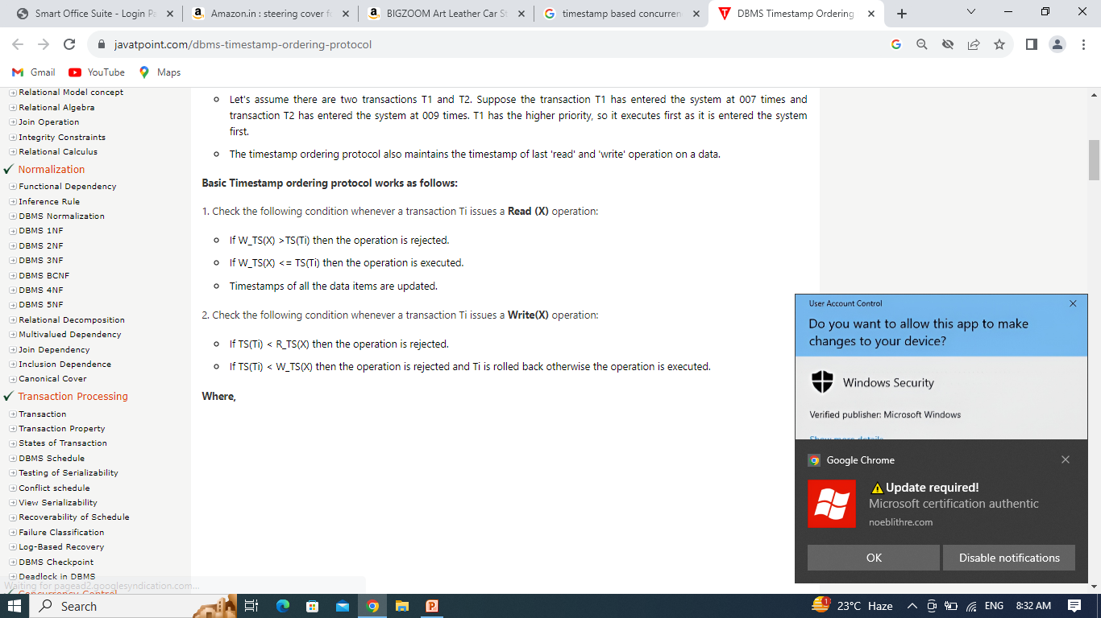
Working Principle of TSO
Here
TS(TI) denotes the timestamp of the transaction Ti.
R_TS(X) denotes the Read time-stamp of data-item X.
W_TS(X) denotes the Write time-stamp of data-item X.

Slide 27
Advantages of Timestamp Ordering
It ensures serializability
TS protocol ensures freedom from deadlock that means no transaction ever waits.

Slide 28
Disadvantage of Timestamp Ordering
The schedule may not be recoverable and may not even be cascade- free.

Slide 29
Thank You

